Slide 1
Shower Vent
Prototype v0.1.1
By: TS, Daniel, and Joshua
Notes:
Josh: Hi everyone, [ “I’m Josh” ], [ “I’m TS” ], [ “I’m Daniel” ], and our project is about an automated shower vent!

Slide 2
Terminology
Common terminology we used in this project
Power Button | A momentary contact switch. Treated as a toggle in the program so it toggles the system on or off.
Venting system | Controlled by a stepper motor (acting as fan) and a servo motor (acting as vent gate). Either is “on” and “open” or “off” and “closed” respectively.
Manual Vent | A different momentary contact switch. Treated as an override in the program toggling the venting system on and off.
Humidity sensor | Custom in house made humidity sensor. Used for the automatic activation of the venting system.
Debounce time | A “continue venting” timer after the humidity sensor has readings BELOW preconfigured high humidity.
Notes:
Josh

Slide 3
The Problem
What is the problem we’re solving?
Notes:
Daniel: Like the great future engineers we are we asked ourselves what’s the problem that we want to change lives with solving.

Slide 4
Mold In Your Bathroom
Health related concerns
Allergic reactions
Constant sneezing
Frequent nose bleeds
Property damage concerns
Wood rot
Persistent unpleasant odor
Surface degradation
Notes:
Daniel: “ Mold forms in damp warm places and after a steamy hot shower the bathroom is a wet dream if you’re mold. Everyone hates mold I haven't heard one person say they like mold except for when they invented penicillin. Its nasty on food and causes health problems like allergic reactions, sneezing, and nose bleeds. It also destroys the infrastructure of your lovely home.”

Slide 5


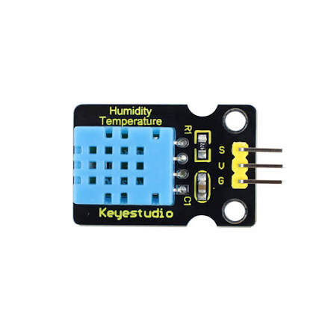
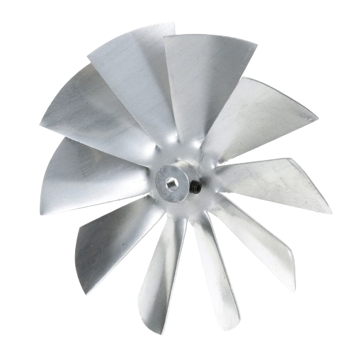


Our Vision
Notes:
Daniel

Slide 6
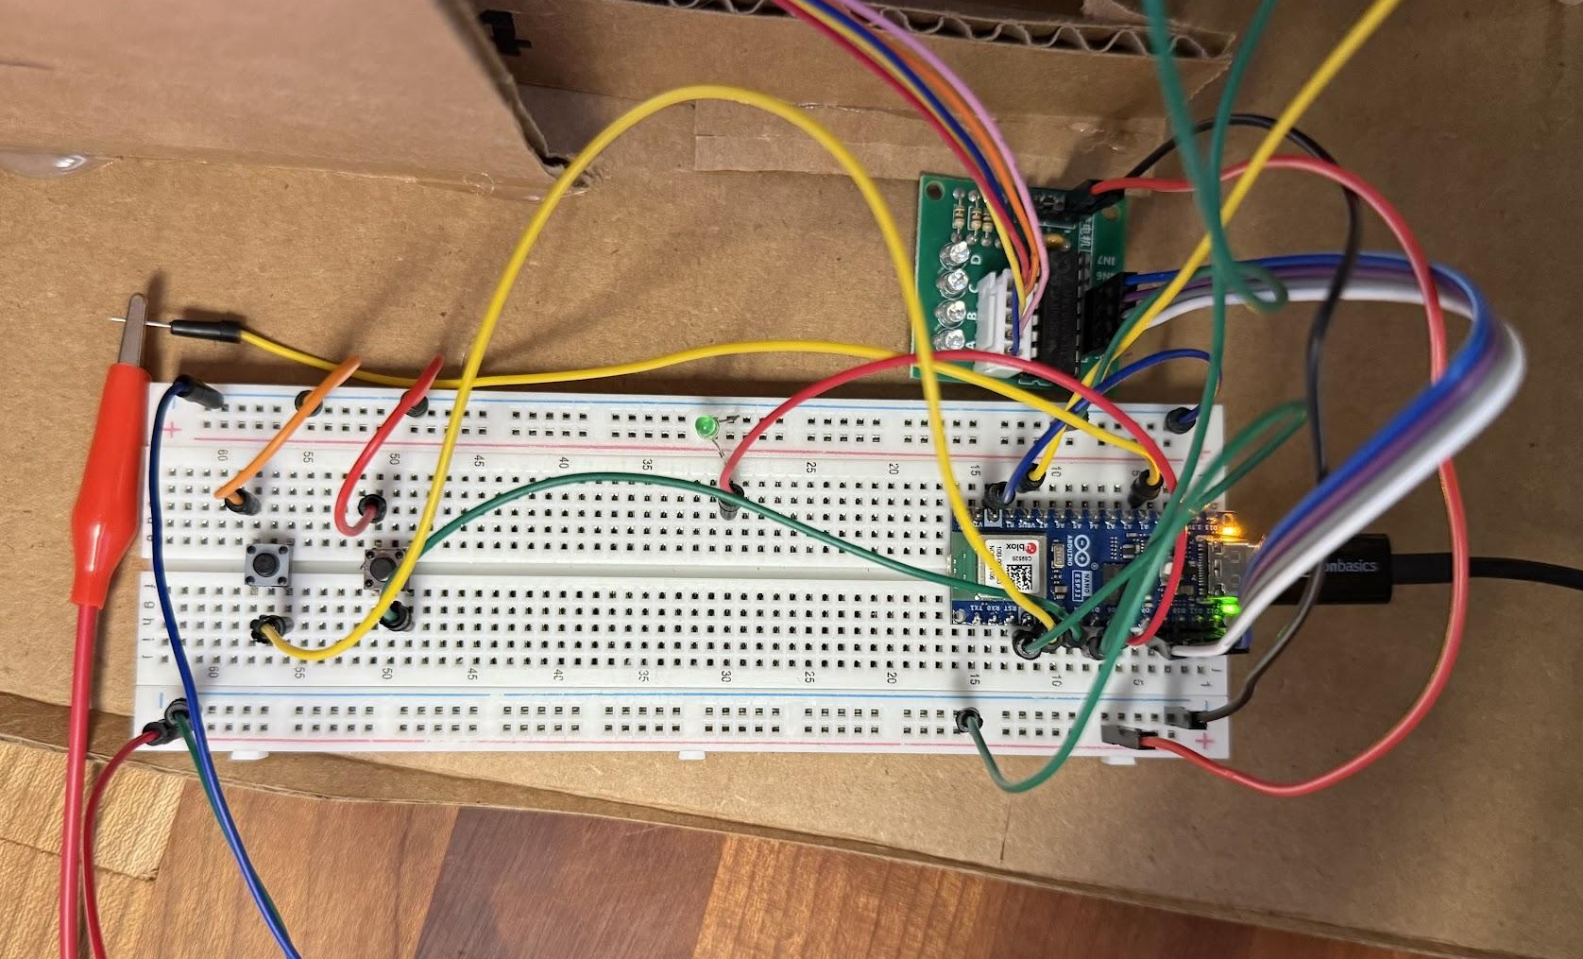
Key Components
Arduino
Humidity Sensor
Manual override
A small microcontroller which controls the entire venting system automatically.
Automatically detects when the room is too humid and sends the signal to the arduino
A button which manually toggles on the venting system
Notes:
Josh

Slide 7

Our AI Usage
Claude Sonnet 5 “High”
  To generate the code.
  To debug our code.
  To research wiring diagrams
Claude Opus 5 “High”
  To align with prototype revisions
Notes:
Josh: “TO align with prototype revisions” is more towards when we changed the DC motor to a stepper motor. We needed to update our code so it controls the stepper motor properly!

Slide 8
How does it work?
(Software)
High humidity
Humidity drop
Humidity remains low
In conditions of high humidity, the vent turns on.
When humidity drops, the vent remains on for a debounce time.
After debounce time elapsed, the vent system turns off.
Notes:
TS Presenting

Slide 9
How does it work?
(Hardware Interface)
Power Button
Manual override
It's a toggle!
Turns on and off the microcontroller.
Regardless of condition, when pressed, venting systems turn on
Venting system remains on until the manual override is turned off.
Notes:
TS Presenting

Slide 10
How does this solve problems?
Hands off
Mold Growth
In default automatic mode, you can’t forget to turn on the vent.
Still reduces mold growth chance
Electricity Costs
Built in Redundancy
Fan having downtime saves power
Manual override buttons in case of sensor failure.
Notes:
TS Presenting

Slide 11
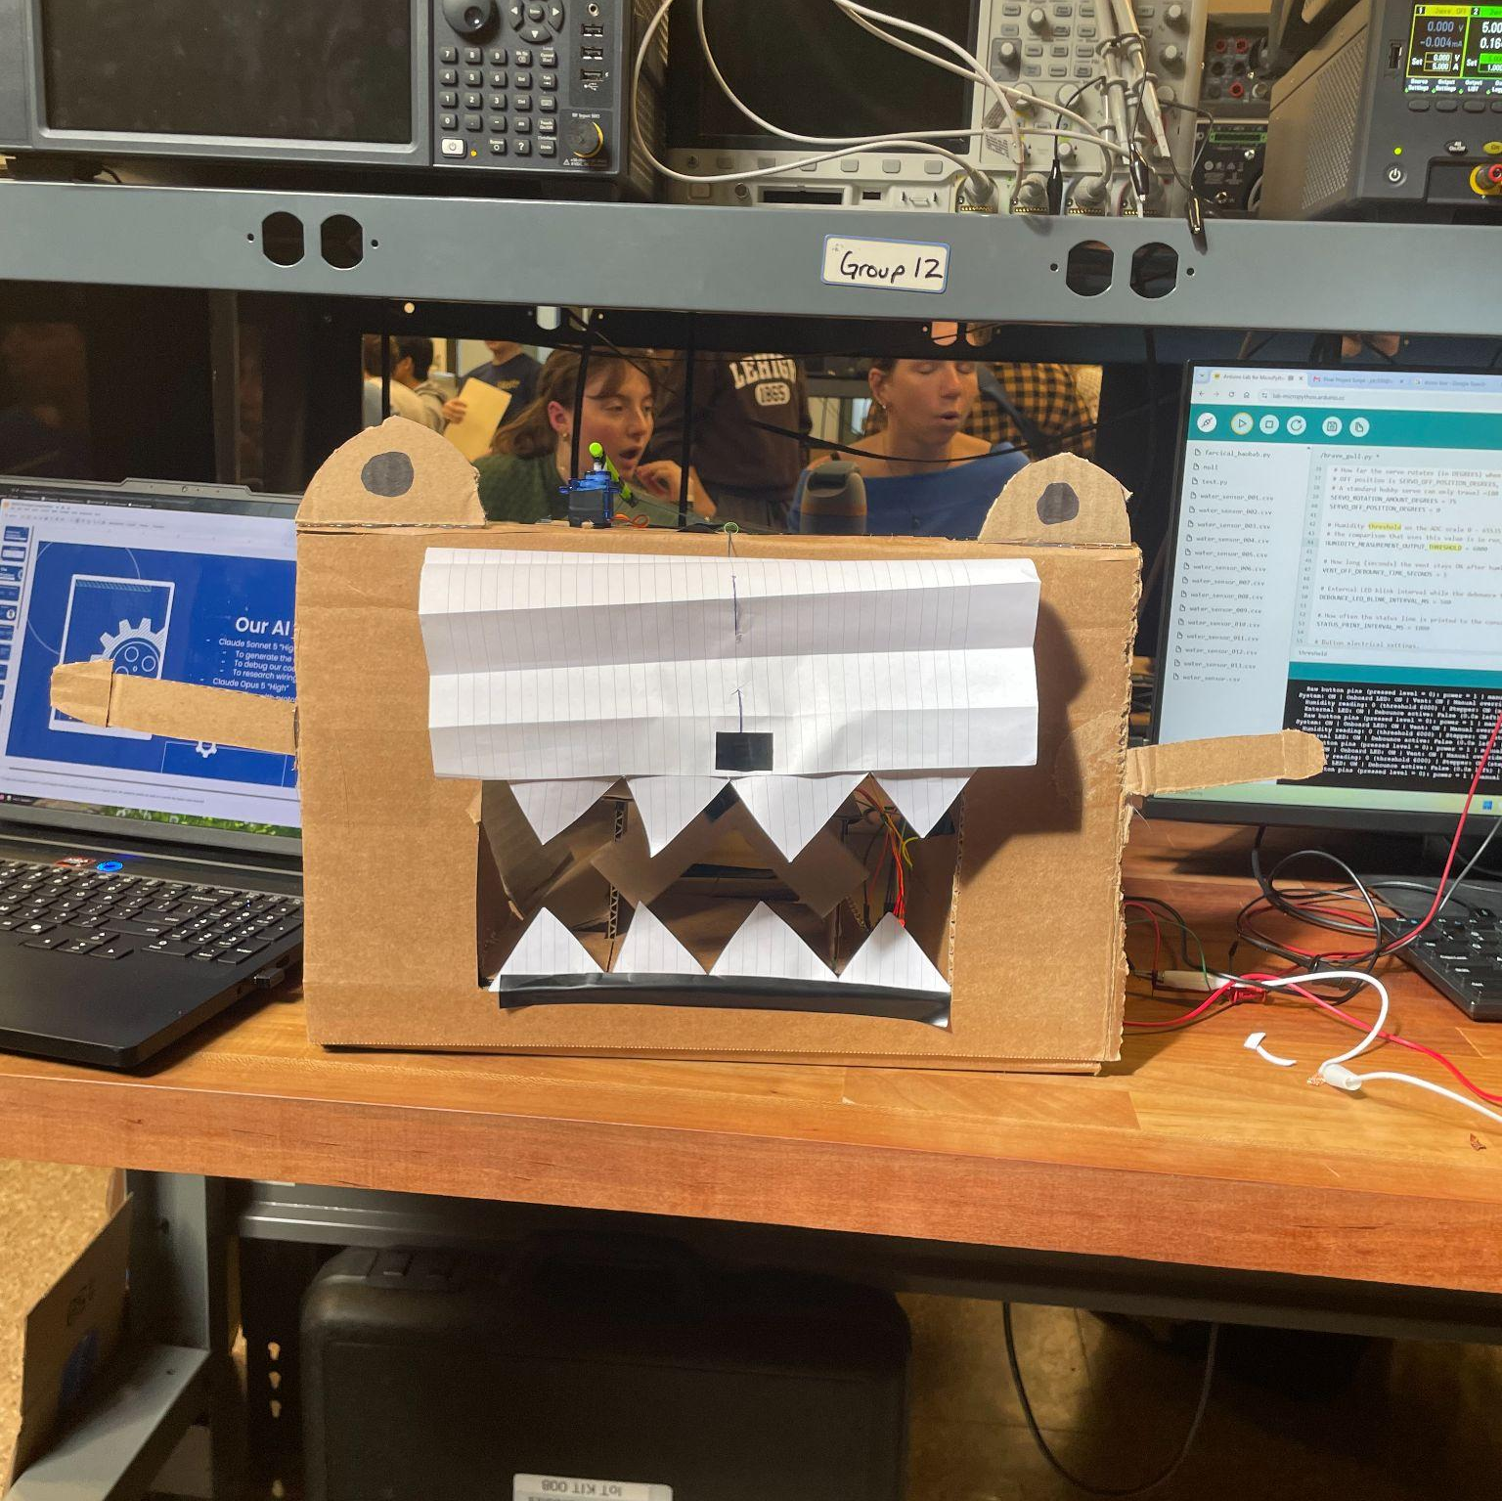
Thanks!
Do you have any questions?

